Slide 1
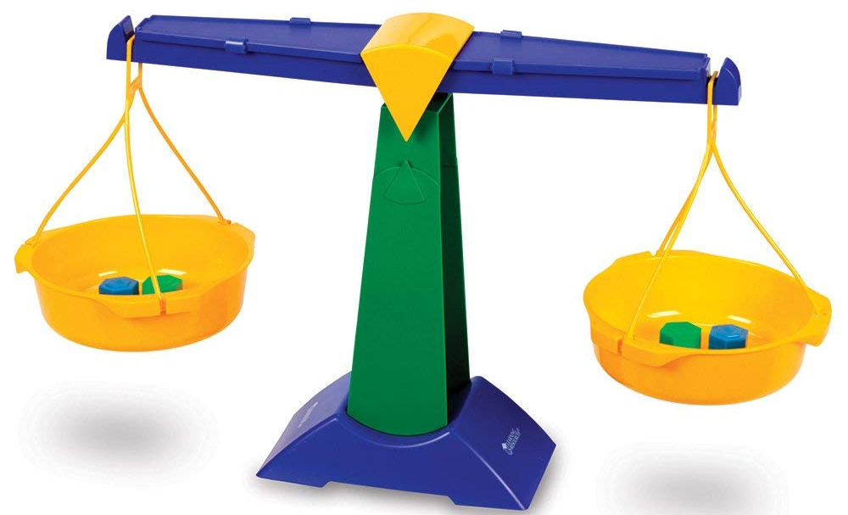
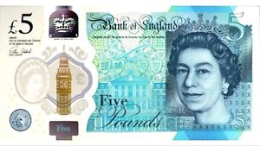
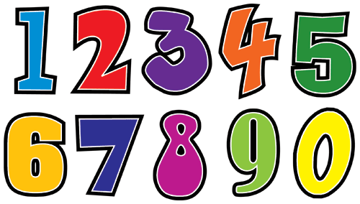
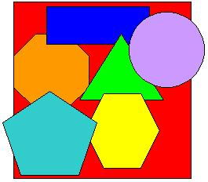

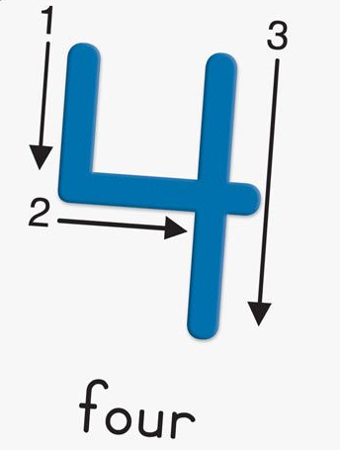

Maths in the
EYFS
Helping your children at home

Slide 2
Reception
Developing a strong grounding in number is essential so that all children develop the necessary building blocks to excel mathematically.
Children should be able to:
  Count confidently
  Develop a deep understanding of the numbers to 10
  Understand the relationships between numbers and patterns within numbers 10
It is important that children develop positive attitudes and interests in mathematics, look for patterns and relationships, spot connections, ‘have a go’, talk to adults and peers about what they notice and not be afraid to make mistakes.

Slide 3
Maths at St. Andrews
There will be a taught session every day to develop maths skills.
When appropriate, there are adult led focus activities and independent challenges set for the children to complete.
The focus for much of the year will be on numbers within 10. This does not mean your child cannot continue to work on number recognition and counting beyond 10.

Slide 4
Subitising: A key skill in reception
It is recognising how many there are, without counting.
The cardinal value of a number refers to the quantity of things it represents, e.g. the numerosity, ‘howmanyness’, or ‘threeness’ of three. When children understand the cardinality of numbers, they know what the numbers mean in terms of knowing how many things they refer to.
Children enjoy learning the sequence of counting numbers long before they understand the cardinal values of the numbers.
Subitising helps children learn addition and subtraction facts and provides a strong foundation for future maths.

Slide 5
Mastering Number 2021/22 ncetm.org.uk

Slide 6
Mastering Number 2021/22 ncetm.org.uk

Slide 7
Mastering Number 2021/22 ncetm.org.uk

Slide 8
Mastering Number 2021/22 ncetm.org.uk

Slide 9
Mastering Number 2021/22 ncetm.org.uk

Slide 10
Mastering Number 2021/22 ncetm.org.uk

Slide 11
Maths fluency
This helps us move onto looking at the ‘composition of number’.
We can see the numbers/amounts within a whole.
Having a deep understanding of numbers to 10 will help with future addition and subtraction.

Slide 12
Mastering Number 2021/22 ncetm.org.uk

Slide 13
Mastering Number 2021/22 ncetm.org.uk

Slide 14
Mastering Number 2021/22 ncetm.org.uk

Slide 15
Mastering Number 2021/22 ncetm.org.uk

Slide 16
Mastering Number 2021/22 ncetm.org.uk

Slide 17
Mastering Number 2021/22 ncetm.org.uk

Slide 18
Mastering Number 2021/22 ncetm.org.uk

Slide 19
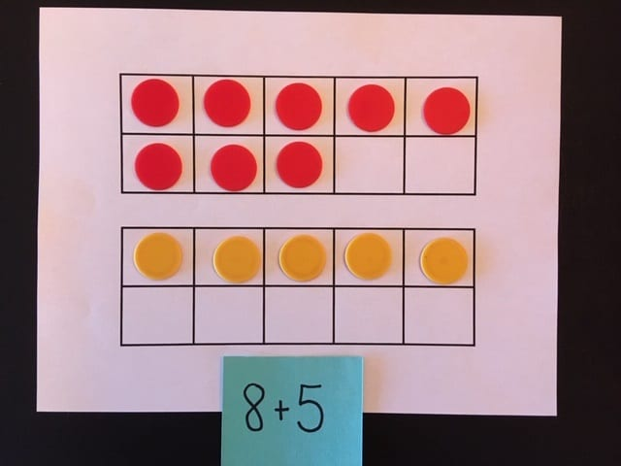
How will this help in KS1?

Slide 20
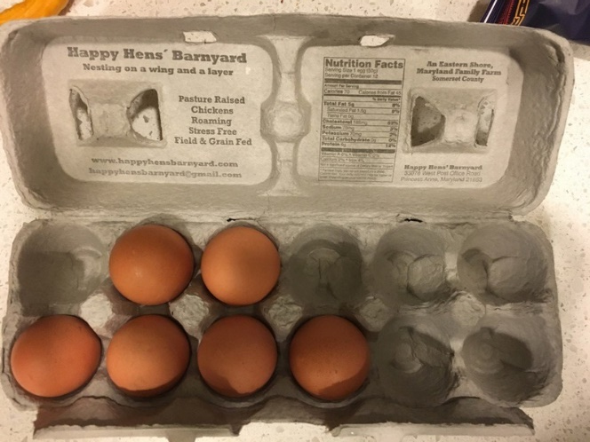
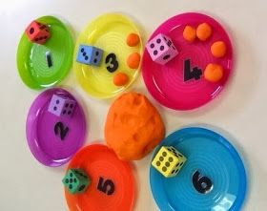
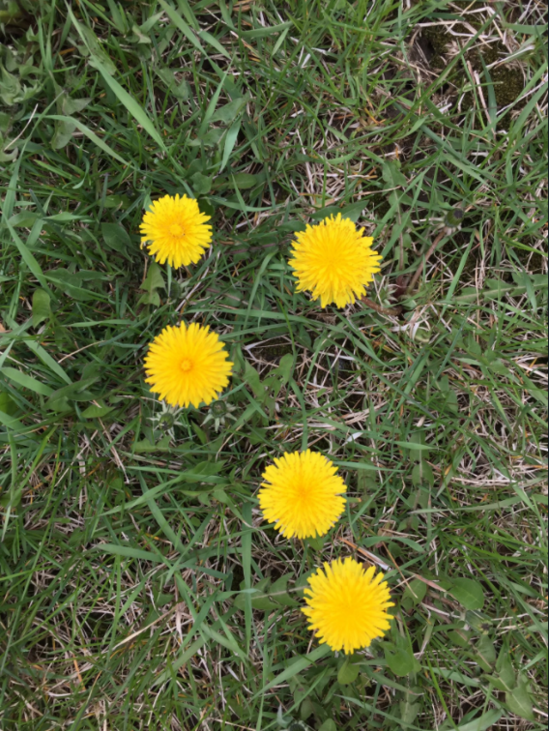
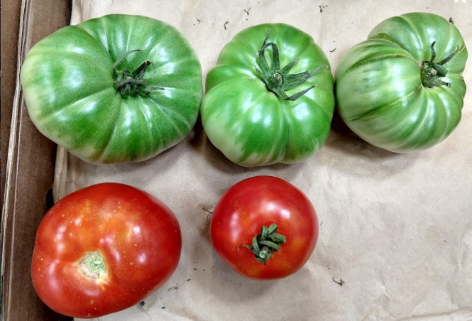
Subitising with different patterns and objects
Dice games
Hands on their heads
Looking at an amount in a range of ways
Subitising games

Slide 21
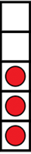
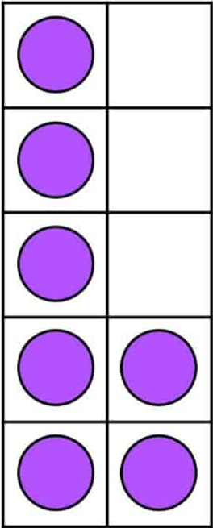
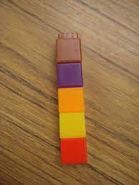
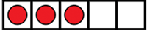
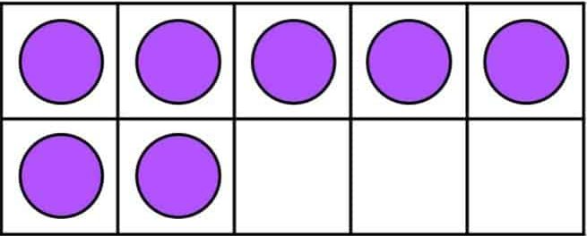
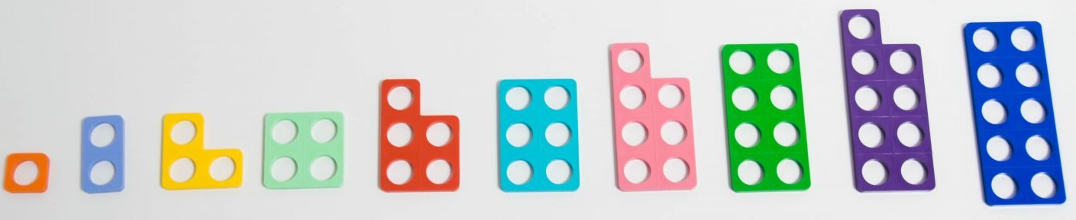
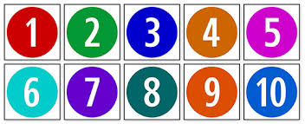
Representation of number
dot
patterns
five and tens
frames
objects
numicon
numerals

Slide 22
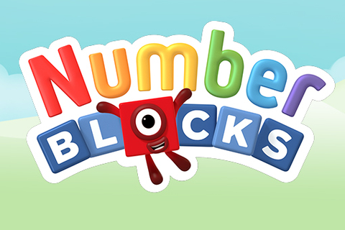
Numberblocks
Numberblocks will be used as a supporting material to help bring numbers and ideas to life in the world around them.
We will look at each number throughout the year, giving children an opportunity to deepen their understanding of…
The amount
What makes up that number (composition)
Where it sits within the number system in relation with other numbers
How to form that number
The National Centre for Excellence in the Teaching of Mathematics

Slide 23
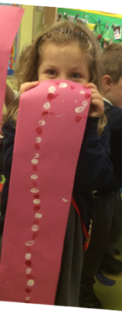

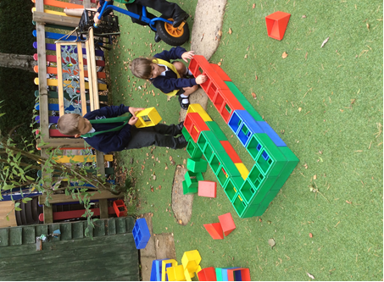
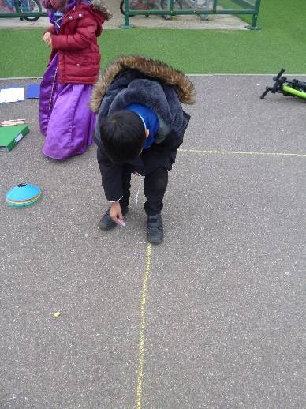
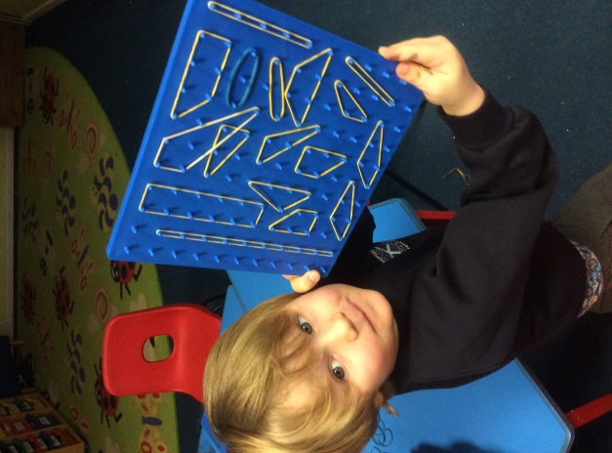
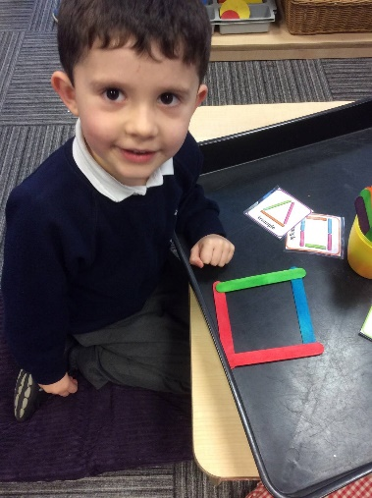
Maths at St Andrews
Hands on
FUN

Slide 24
Early Learning Goal (Expectation for the end of Reception)
Children at the expected level of development will:
Have a deep understanding of numbers to 10, including composition of each number
Subitise (recongise quantities without counting) up to 5
Automatically recall (without reference to rhymes, counting or other aids) number bonds up to 5 (including subtraction facts) and some number bonds to 10, including double facts.
Number
Early Learning
Goal

Slide 25
Early Learning Goal (Expectation for the end of Reception)
Children at the expected level of development will:
Verbally count beyond 20, recognising the pattern of the counting system
Compare quantities up to 10 in different contexts, recognising when one quantity is greater than, less than or the same as the other quantity
Explore and represent patterns within numbers to 10, including evens and odds, double facts and how quantities can be distributed equally.
Numerical Patterns
Early Learning
Goal

Slide 26
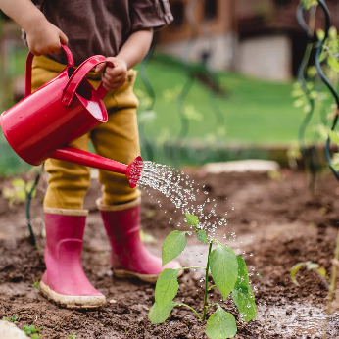
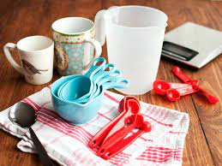
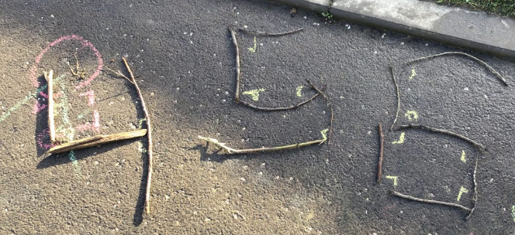
Supporting your child at home with maths
Play lots of games-
including board games
Point out maths in everyday life
measuring
shopping
cooking
Be positive about maths!
Don’t say you couldn’t do maths or hated maths.
For children to be good at maths, they need to feel confident about giving it a go
Praise your child for the effort they are putting in, not for how ‘clever’ they are.
Working hard and practising will help them to improve.

Slide 27


Think about language
Everyday language moving to mathematical language
General | Mathematical
Big, small | Biggest, smallest, bigger, smaller, longer, shorter, taller
Round one, flat one | Circle, square, sphere, cube, corner, edge
Heavy, light, full, empty | Heaviest, lightest, balanced, the same
On, in, under | Behind, next to, in between
Less, more, a lot, the same | Add, plus, altogether, makes, equals, take away, share, half, double
Today, tomorrow | Before, later, soon, weekend

Slide 28



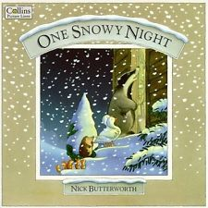

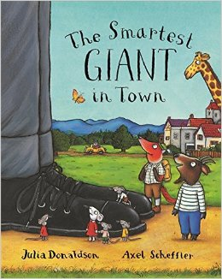


Maths in books
Days of the week
Money
Clock times
One more - addition
Counting and addition
Vocabulary and problem solving related to size
One less - subtraction
Concept of more

Slide 29
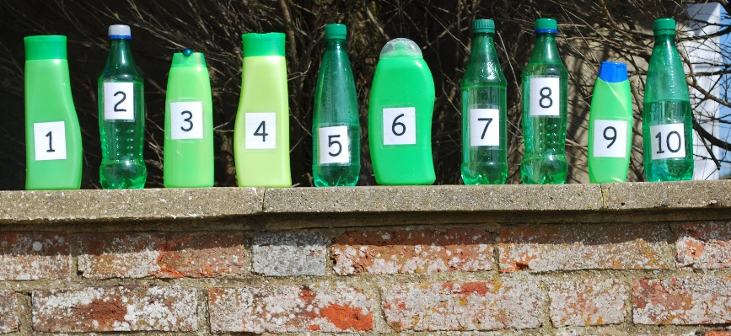
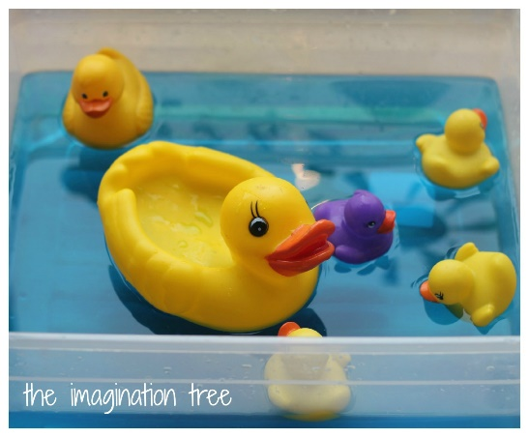
Songs and Rhymes
Ten Green Bottles
Five Little Ducks

Slide 30


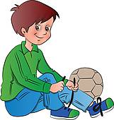


In the home
Counting the stairs as you go up and down them.
Setting the table and counting out the plates, knives and forks.
Counting how long it takes to put shoes on
Identifying the coins they have for pocket money and counting how much.
Identifying numerals around the house.

Slide 31
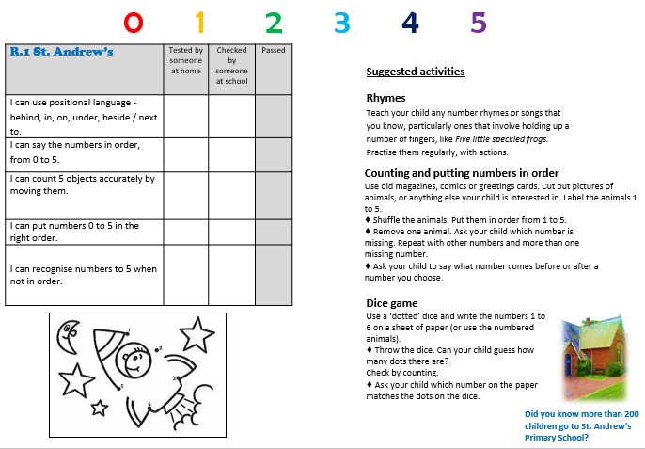

Slide 32
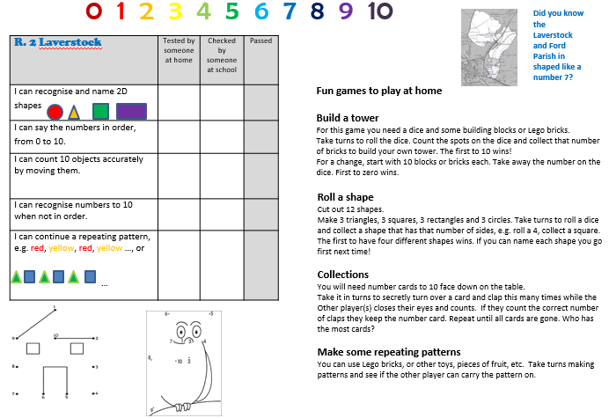

Slide 33
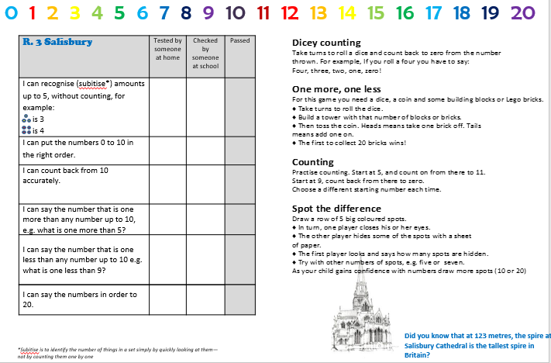

Slide 34
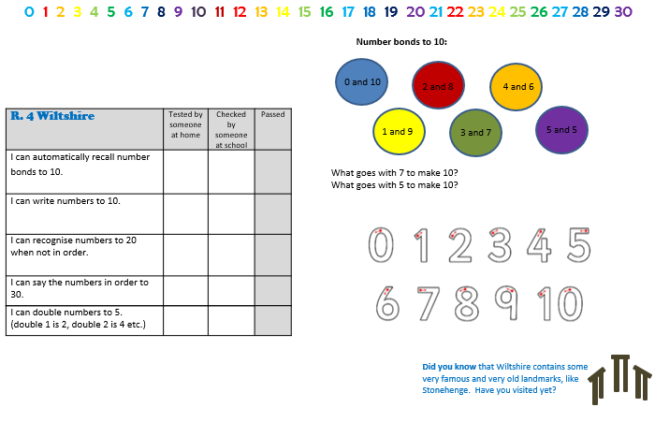

Slide 35

Other apps
White Rose Maths App
Helps children build greater confidence and fluency
Busy things
Kids counting
Math age 3-5
Let’s create

Slide 36

Thank you for coming!

